Slide 1

Robot Modeling & Control ME331
Section 14： Dynamics IV
Chenglong Fu（付成龙）
Dept. of MEE ，SUSTech
Notes:
只上一节课

Slide 2
Outline
Review
Some Common Configurations
Properties of Dynamic Equations
Generalized Forces
Impact Dynamics
Using MATLAB to Obtain the Model
Examples: dynamic biped walking
Notes:
机器人构形、指标

Slide 3
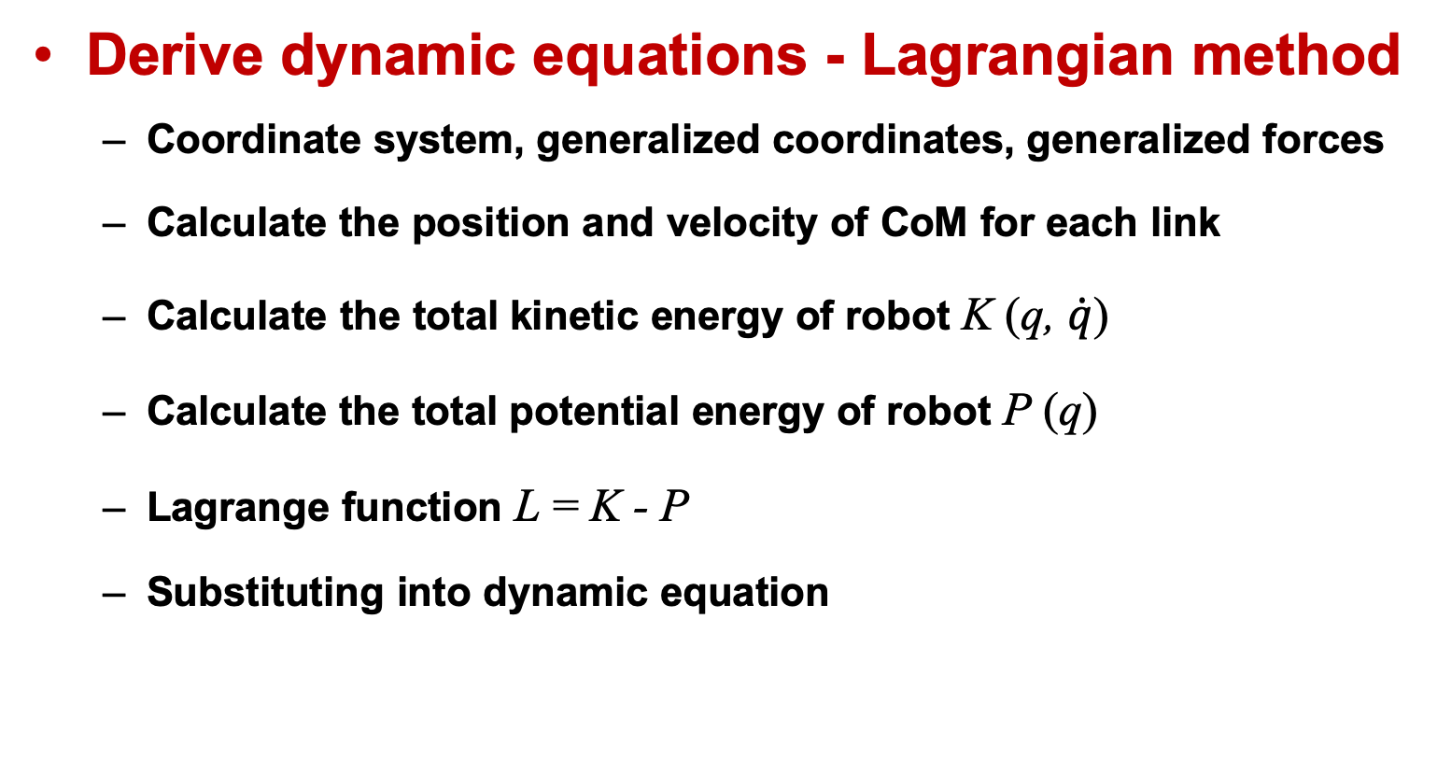
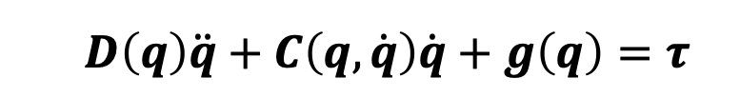
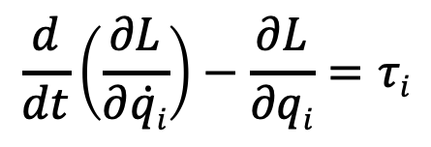
Equations of Motion
Derive dynamic equations - Lagrangian method
Coordinate system, generalized coordinates, generalized forces
Calculate the position and velocity of CoM for each link
Calculate the total kinetic energy of robot K (q, $\dot{q}$)
Calculate the total potential energy of robot P (q)
Lagrange function L = K - P
Substituting into dynamic equation
$$\frac{d}{dt}\left(\frac{∂L}{∂\dot{qi}}\right)−\frac{∂L}{∂qi}=τi$$
$$D\left(q\right)\ddot{q}+C\left(q,\dot{q}\right)\dot{q}+g\left(q\right)=τ$$
Notes:
动能包括：质心平动动能，绕质心的转动动能
势能包括重力势能和弹性势能

Slide 4
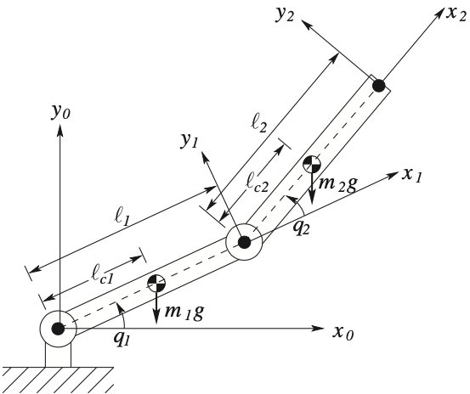
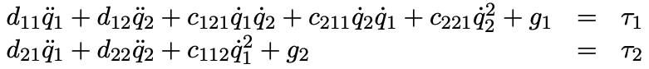
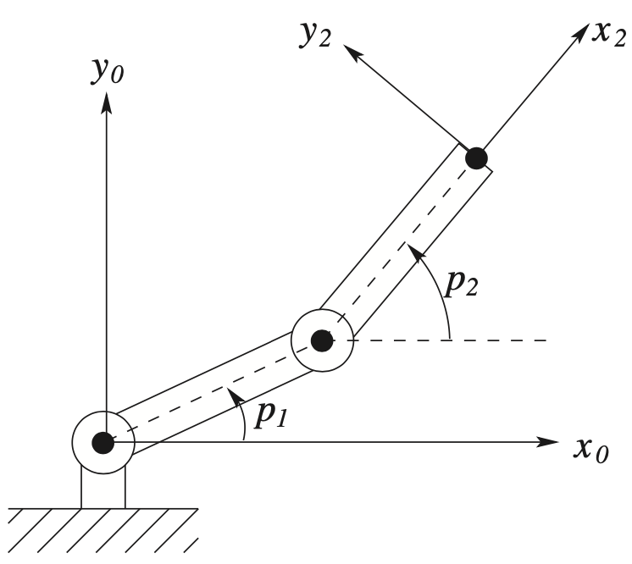
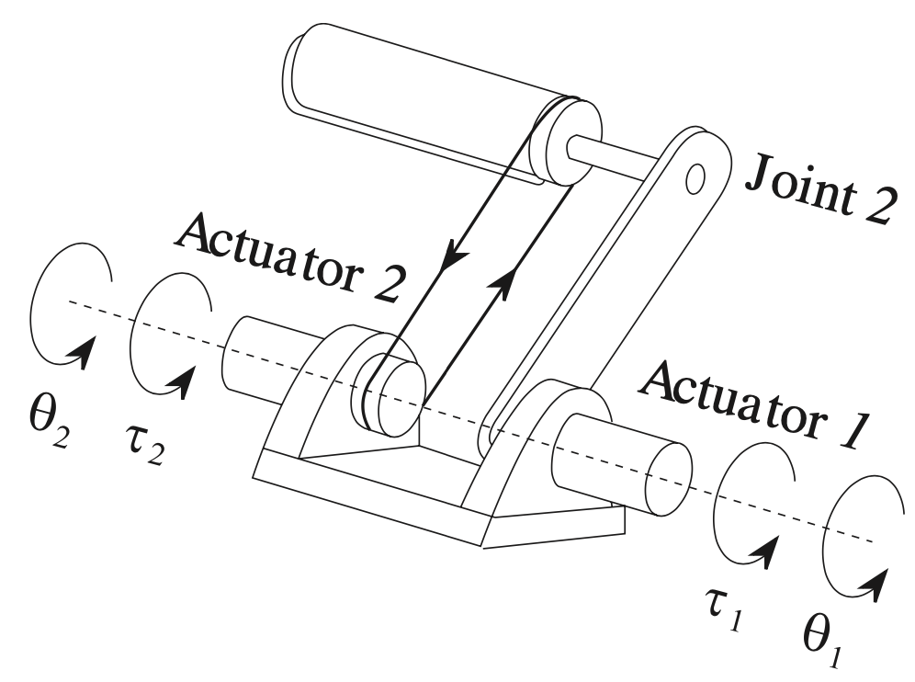
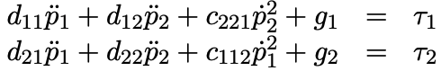
Some Common Configurations
Planar Elbow Manipulator
Notes:
势能仅是广义坐标的函数，与速度无关；
势能包括重力势能和弹性势能

Slide 5
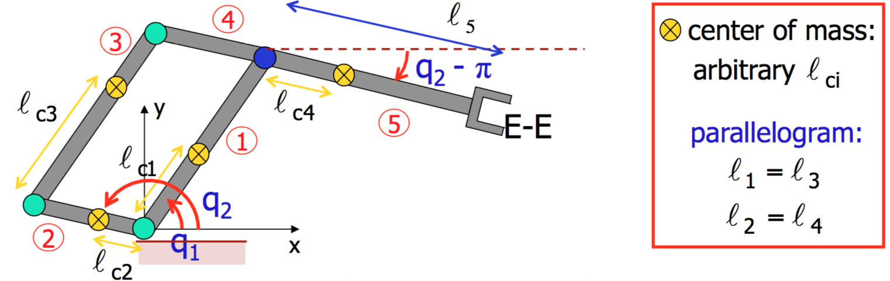
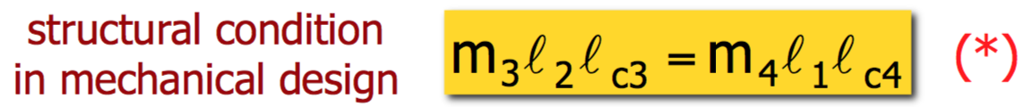
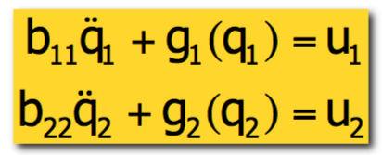
Robots with parallelogram structure
D(q)

Slide 6
Properties of Dynamic Equations
Skew Symmetry
$$D\left(q\right)\ddot{q}+C\left(q,\dot{q}\right)\dot{q}+g\left(q\right)=τ$$
$$ckj=\sum_{i=1}^{n}{\frac{1}{2}\left\{\frac{∂dkj}{∂qi}+\frac{∂dki}{∂qj}−\frac{∂dij}{∂qk}\right\}}\dot{q}i$$
$$dkj$$
$N\left(q,\dot{q}\right)≡\dot{D}\left(q\right)−2C(q,\dot{q})$ is skew symmetric, that is :$njk=−nkj$
Passivity
$$\int_{0}^{T}{{\dot{q}}^{T}\left(t\right)τ\left(t\right)dt}≥−β, ∀ T>0$$
There exists a constant $β≥0$, such that
1. The term ${\dot{q}}^{T}τ$ has units of power. Thus, $\int_{0}^{T}{{\dot{q}}^{T}\left(t\right)τ\left(t\right)dt}$ is the energy produced by the system over the time interval [ 0, T ].
2. Passivity means that the amount of energy dissipated by the system has a lower bound given by $−β$.
Notes:
系统不能产生能量，只能消耗或存储能量。比如电路中的无源元件如电阻、电容、电感，它们不会自己产生能量，电阻消耗能量，而电容和电感存储能量。所以在动力学系统里，无源性可能意味着系统内部没有能量源，所有的能量变化来自于外部输入和内部的耗散或存储。无源性是否要看输入输出的乘积积分是否有下界？也就是是否存在某个存储函数，使得系统的能量变化不超过输入所做的功。机器人控制：机械臂动力学方程通常是无源的，利用无源性设计控制器可确保稳定性

Slide 7
Properties of Dynamic Equations
Bounds of Inertial Matrix
One can find constants $λm$ and $λM$ that provide uniform (independent of $q$) bounds in the inertia matrix
$$λmI_{n×n}≤D\left(q\right)≤λMI_{n×n}<∞$$
Linearity in the Parameters
The equations of motion are linear in these inertia parameters. There exists an $n×l$ function, $Y(q,\dot{q},\ddot{q})$ and an $l$-dimensional vector $Θ$ such that the Euler–Lagrange equations can be written as：
$$D\left(q\right)\ddot{q}+C\left(q,\dot{q}\right)\dot{q}+g\left(q\right)=Y\left(q,\dot{q},\ddot{q}\right)Θ$$
where function $Y\left(q,\dot{q},\ddot{q}\right)$ is called the regressor (回归量) and $Θ∈ℝ^{l}$ is the parameter vector (参数向量).
Notes:
惯性矩阵具有一致的界限（与广义坐标q无关），可以找到常数$λm$和$λM$使得

Slide 8
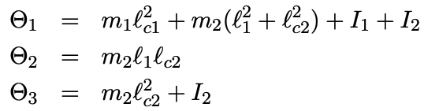
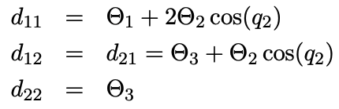
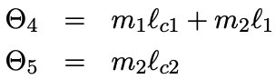
Properties of Dynamic Equations
Linearity in the Parameters
If we group the inertia terms as
then we can write the inertia matrix elements as
No additional parameters are required in the Christoffel symbols. However, the gravitational torques generally require additional parameters. Setting
Notes:
一个独立的刚体具有10个动力学参数：总质量、质心的3个位置坐标、惯性张量中6个独立元素。。惯性张量是对称矩阵
注：n-连杆机器人最多有10n个动力学参数，但由于连杆运动受到约束并且通过关节互连而相互耦合，实际上的独立参数数目少于10n。

Slide 9
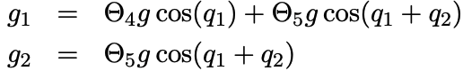
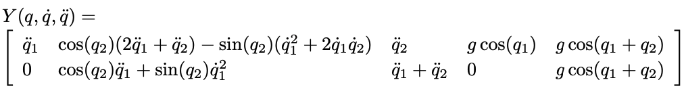
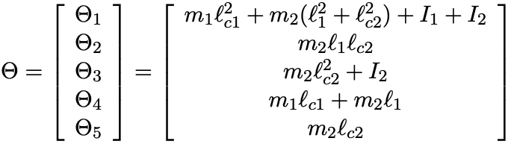
Properties of Dynamic Equations
Linearity in the Parameters
we can write the gravitational terms g₁ and g₂ as
$$D\left(q\right)\ddot{q}+C\left(q,\dot{q}\right)\dot{q}+g\left(q\right)=Y\left(q,\dot{q},\ddot{q}\right)Θ$$
Notes:
一个独立的刚体具有10个动力学参数：总质量、质心的3个位置坐标、惯性张量中6个独立元素。。惯性张量是对称矩阵
注：n-连杆机器人最多有10n个动力学参数，但由于连杆运动受到约束并且通过关节互连而相互耦合，实际上的独立参数数目少于10n。

Slide 10
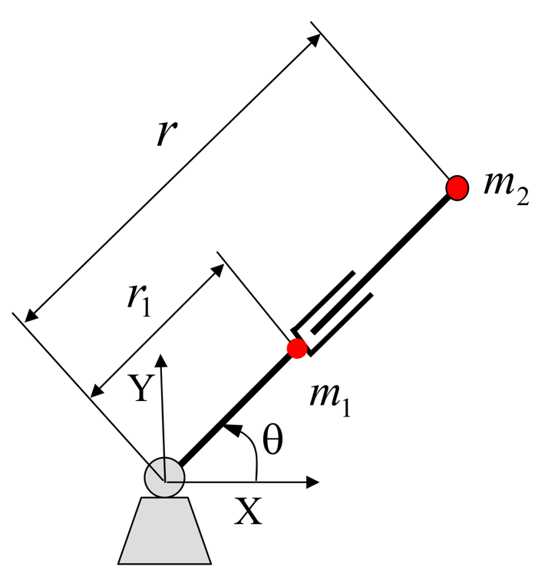
Generalized Forces
How to obtain the generalized forces f₁ and f₂ ?
The virtual work:
$$δW=\sum_{i}{\left(f_{i}{δq}_{i}\right)}$$
$$F$$
Except for $q_{i}$, let the virtual displacement of the remaining joints be zero. Then $f_{i}$ can be written as
$$f_{i}=\frac{δW}{{δq}_{i}}$$
$$τ$$
${ δq}_{1} =$ $δθ$
$$δW=τδθ$$
$$f_{1}=\frac{δW}{{δq}_{1}}=\frac{τδθ }{δθ }=τ$$
${ δq}_{2} =$ $δr$
$$δW=Fδr$$
$$f_{2}=\frac{δW}{{δq}_{2}}=\frac{Fδ\text{r} }{δr }=F$$
The form of generalized forces depends on the the selection of generalized coordinates!
Notes:
The form of generalized forces depends on the the selection of generalized coordinates!

Slide 11
Generalized Forces
Example: Derive the Generalized forces for the following two cases.
$$f_{i}=\frac{δW}{{δq}_{i}}$$
$$τ2$$
$${ q}_{2}$$
$$τ2$$
$${ q}_{2}$$
$$τ1$$
$$τ1$$
$${ q}_{1}$$
$${ q}_{1}$$
$$f_{1}=？$$
$$f_{2}=？$$
$$f_{1}=？$$
$$f_{2}=？$$
Notes:
大约需要10分钟测验,

Slide 12
Generalized Forces
Actuation torques（驱动转矩）
$$D\left(q\right)\ddot{q}+C\left(q,\dot{q}\right)\dot{q}+g\left(q\right)=Bτ$$
Viscous damping（阻尼力）
$$D\left(q\right)\ddot{q}+C\left(q,\dot{q}\right)\dot{q}+g\left(q\right)=Bτ−Fv\dot{q}$$
where $Fv$ is the coefficient of damping matrix（n$×$n, diagonal）.
Coulomb friction（摩擦力）
$$D\left(q\right)\ddot{q}+C\left(q,\dot{q}\right)\dot{q}+g\left(q\right)=Bτ−Fv\dot{q}−Fssgn(\dot{q})$$
where $Fs$ is the coefficient of friction matrix（n$×$n, diagonal）, and
$sgn(\dot{q})$ is the vector of sign function (n$×1$)，determined by the sign of the joint velocity.
Notes:
$Fv$ 表示由粘滞摩擦系数构成的（n$×$n）对角阵。

Slide 13
Generalized Forces
Contact forces
Interaction of the manipulator with the environment produces forces and moments at the end effector or tool. These, in turn, produce torques at the joints of the robot.
f
n
Jacobian J
Joint
space
Task
space
J ^{T}$\left(q\right)\vec{F}$
Force Jacobian J ^{T}
$D\left(q\right)\ddot{q}+C\left(q,\dot{q}\right)\dot{q}+g\left(q\right)=Bτ−Fv\dot{q}−Fssgn\left(\dot{q}\right)+$J ^{T}$\left(q\right)\vec{F}$
where $\vec{F}$ represent the vector of forces and moments at the end effector, J $\left(q\right)$ is the transpose of the manipulator Jacobian。
Notes:
为接触点的笛卡尔坐标对系统广义坐标的雅可比矩阵

Slide 14
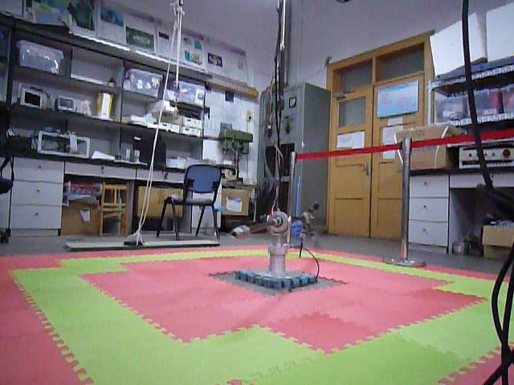
Impact Dynamics
Impact Hypotheses
an impact results from the contact of the swing leg end with the ground;
the impact is instantaneous;
3) the impact results in no rebound and no slipping of the swing leg;
4) at the moment of impact, the stance leg lifts from the ground without interaction;
5) the externally applied forces during the impact can be represented by impulses;
6) the actuators cannot generate impulses and hence can be ignored during impact; and
7) the impulsive forces may result in an instantaneous change in the robot’s velocities, but there is no instantaneous change in the configuration.
Tsinghua Biped Robot（2007）
Notes:
HI1) an impact results from the contact of the swing leg end with the ground;
HI2) the impact is instantaneous; HI3) the impact results in no rebound and no slipping of the swing leg;
HI4) at the moment of impact, the stance leg lifts from the ground without interaction;
HI5) the externally applied forces during the impact can be represented by impulses;
HI6) the actuators cannot generate impulses and hence can be ignored during impact; and
HI7) the impulsive forces may result in an instantaneous change in the robot’s velocities, but there is no instantaneous change in the configuration.

Slide 15
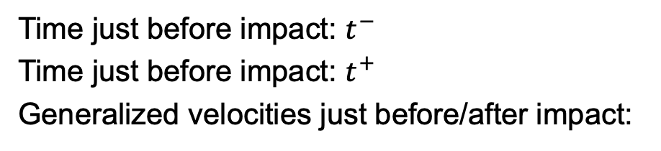
Impact Dynamics
The Cartesian coordinates of rear toe:
The Cartesian coordinates of front heel:
DoF of impact dynamics: N＋2.
Generalized coordinates
Time just before impact: $t^{−}$
Time just before impact: $t^{+}$
Generalized velocities just before/after impact:
Coordinates definition for impact model
Impact Dynamics equation can be written as
Notes:
Impact Dynamics equation can be written as

Slide 16
Impact Dynamics
where . and is the collision force acting at the collision point.
Integrating of RHS over the impact time：
Integrating of LHS over the impact time：
where ,

Slide 17
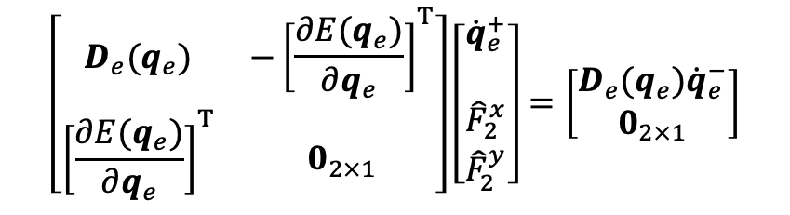
Impact Dynamics
According hypothesis (1)，we have
The above equations can be written together as
$$\left[\begin{matrix}D_{e}(q_{e}) & −{\left[\frac{∂E(q_{e})}{∂q_{e}}\right]}^{T} \\ {\left[\frac{∂E(q_{e})}{∂q_{e}}\right]}^{T} & 0_{2×1}\end{matrix}\right]\left[\begin{matrix}{\dot{q}}_{e}^{+} \\ \\ \begin{matrix}{\hat{F}}_{2}^{x} \\ {\hat{F}}_{2}^{y}\end{matrix}\end{matrix}\right]=\left[\begin{matrix}D_{e}(q_{e}){\dot{q}}_{e}^{−} \\ 0_{2×1}\end{matrix}\right]$$
If have full rank,
where

Slide 18
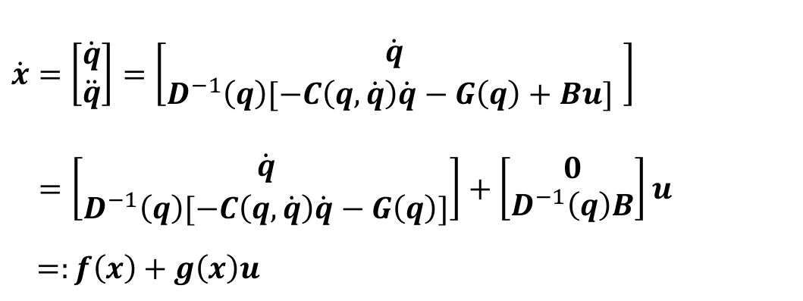
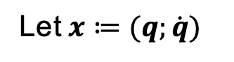
Impact Dynamics
The state space of the model（动力学模型状态空间方程）
$$D\left(q\right)\ddot{q}+C\left(q,\dot{q}\right)\dot{q}+G\left(q\right)=Bu$$
Let$x≔(q;\dot{q})$
$\dot{x}=$ $\left[\begin{matrix}\dot{q} \\ \ddot{q}\end{matrix}\right]=\left[\begin{matrix}\dot{q} \\ D^{−1}\left(q\right)[−C\left(q,\dot{q}\right)\dot{q}−G\left(q\right)+Bu] \end{matrix}\right]$
$$=\left[\begin{matrix}\dot{q} \\ D^{−1}\left(q\right)[−C\left(q,\dot{q}\right)\dot{q}−G\left(q\right)]\end{matrix}\right]+\left[\begin{matrix}0 \\ D^{−1}\left(q\right)B\end{matrix}\right]u$$
$=:f\left(x\right)+g\left(x\right)u$
hybrid system (混合系统)

Slide 19
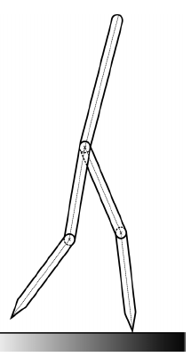
Derive the Lagrangian Dynamics
Tsinghua Biped Robot Prototype
Sagittal plane dynamics
Two legs, knees, torso
No feet (point feet)
Tsinghua Biped Robot (C. Fu, Y. Huang, K. Chen,2007)

Slide 20
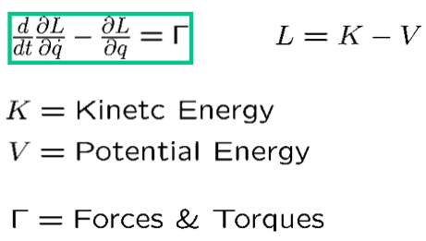
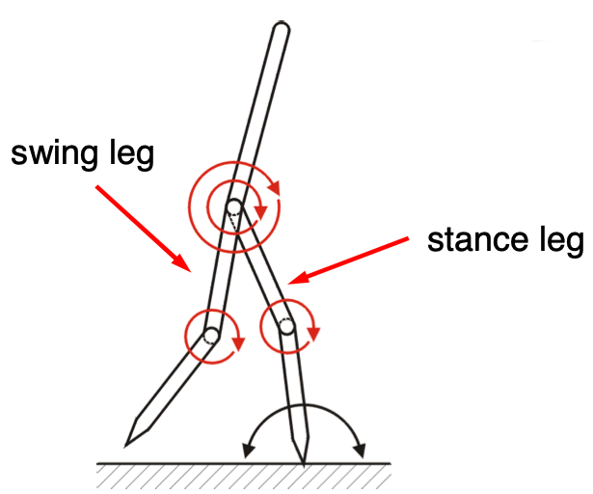
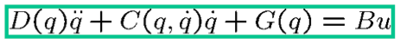
Derive the Lagrangian Dynamics
Lagrange’s Equation
Typical Form in Robotics
4 actuators and 5 links

Slide 21
Computing the Lagrangian
Basic Assumptions in SS
– Stance leg acts as a pivot
– Swing leg is not interacting with the ground
– Rigid links, rigid joints, no joint friction,...
Five Degrees of Freedom
– need 5 generalized coordinates

Slide 22
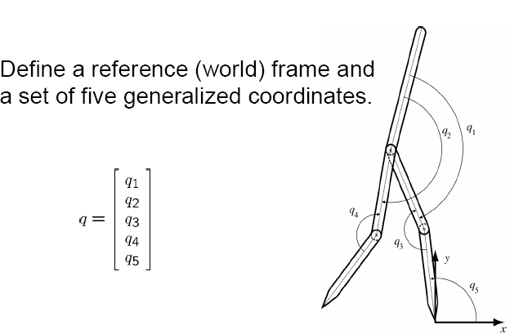
Computing the Lagrangian

Slide 23
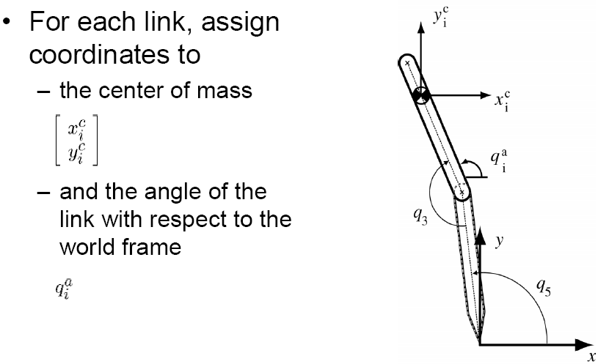
Computing the Lagrangian

Slide 24
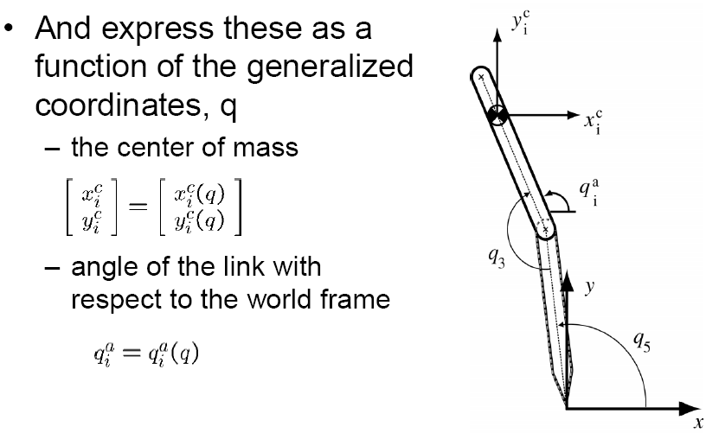
Computing the Lagrangian

Slide 25
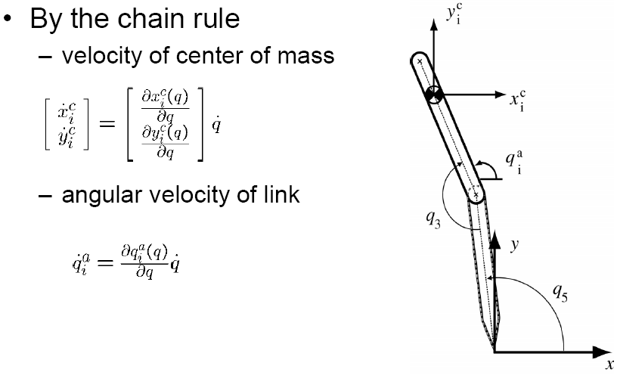
Computing the Lagrangian

Slide 26
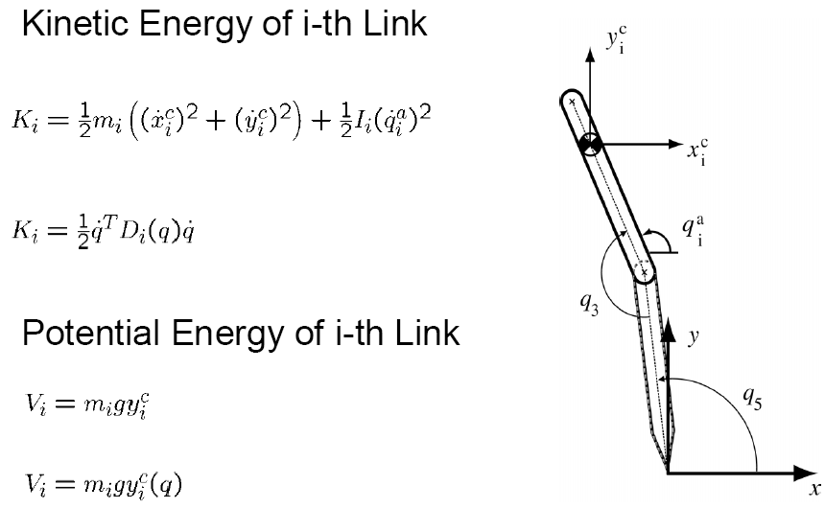
Computing the Lagrangian

Slide 27
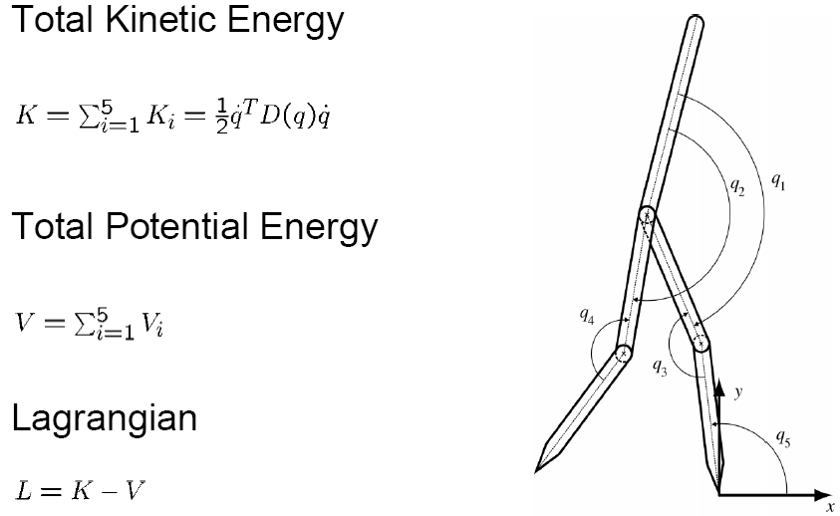
Computing the Lagrangian

Slide 28
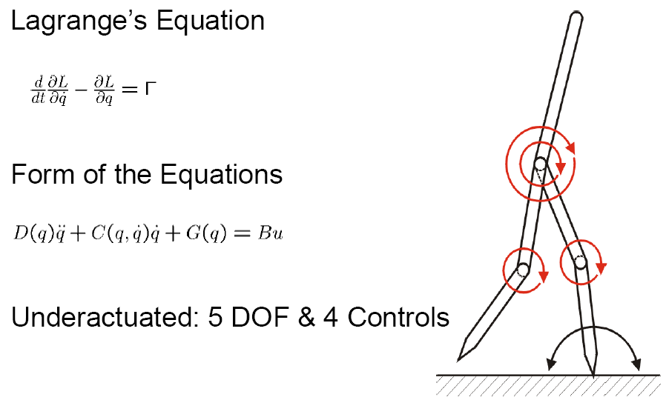
Computing the Lagrangian

Slide 29
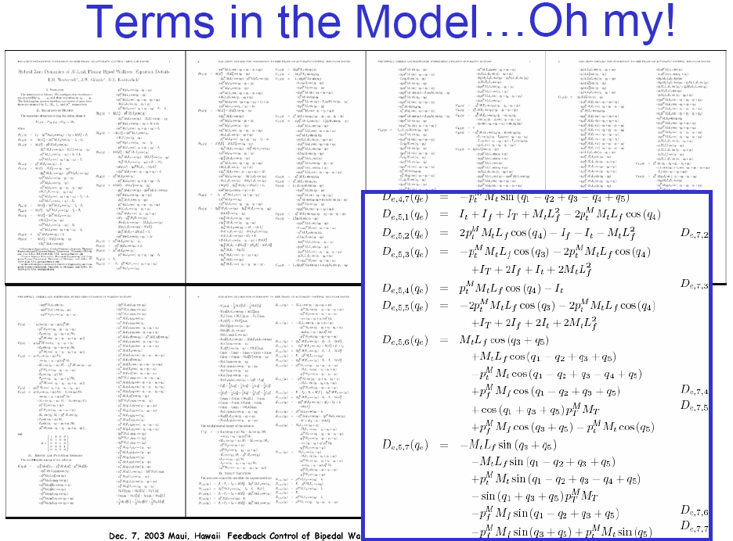

Slide 30
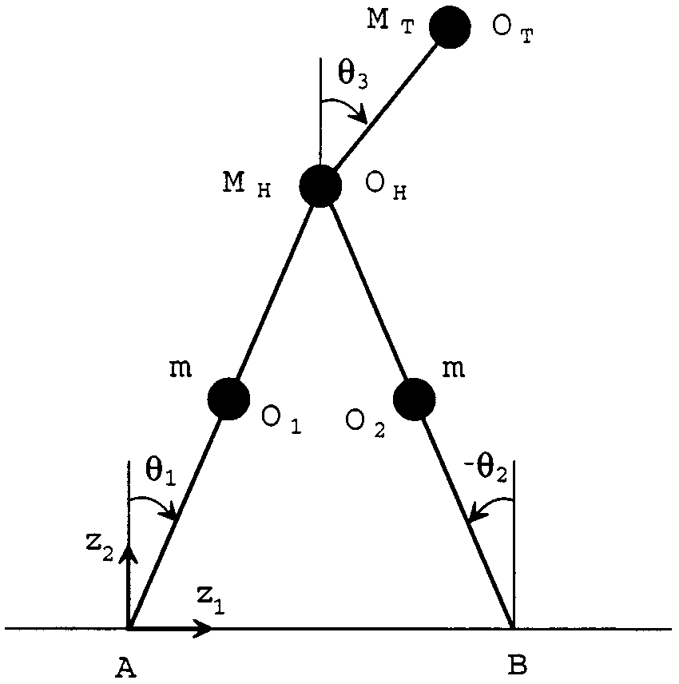
Using MATLAB to Obtain the Model
Using Matlab Symbolic Toolbox to Derive the Model
%% Define symbolic variables
syms q1 q2 q3 dq1 dq2 dq3
syms g m Mh Mt r L positive
%% Define generalized coordinates and generalized velocities
q=[q1 q2 q3].';
dq=[dq1 dq2 dq3].';
%% Calculate the location of center of mass (CoM) for each link
p1=[ 1/2*r*cos(q1), 1/2*r*sin(q1)];
p2=[ r*cos(q1), r*sin(q1)];
p3=p2 + [1/2*r*cos(q1+q2), 1/2*r*sin(q1+q2)];

Slide 31
Using MATLAB to Obtain the Model
Using Matlab Symbolic Toolbox to Derive the Model
%% Calculate the potential energy
PE=g*m*p1(2)+g*Mh*p2(2)+g*m*p3(2);
%% Calculate the CoM velocity for each link
v1=jacobian(p1,q)*dq;
v2=jacobian(p2,q)*dq;
v3=jacobian(p3,q)*dq;
%% Calculate the kinematic energy
KE1=simplify((1/2)*m*v1.'*v1);
KE2=simplify((1/2)*Mh*v2.'*v2);
KE3=simplify((1/2)*m*v3.'*v3);
KE=KE1+KE2+KE3;

Slide 32
Using MATLAB to Obtain the Model
Using Matlab Symbolic Toolbox to Derive the Model
% D(q)ddq + C(q,dq)*dq + G(q) = tau
%% Calculate the inertial matrix
D=jacobian(KE,dq).';
D=jacobian(D,dq);
%% Calculate the gravity vector
G=jacobian(PE,q).';

Slide 33
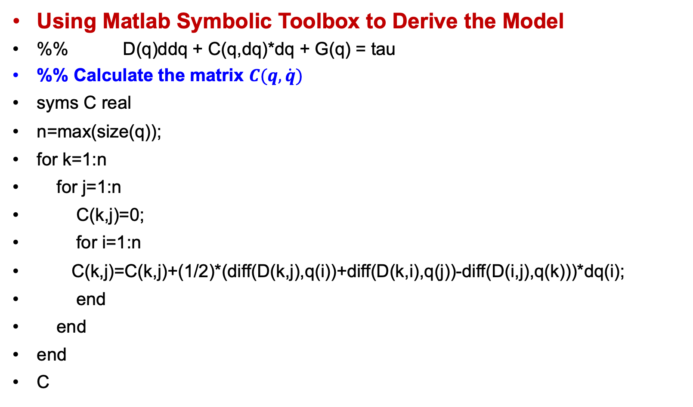
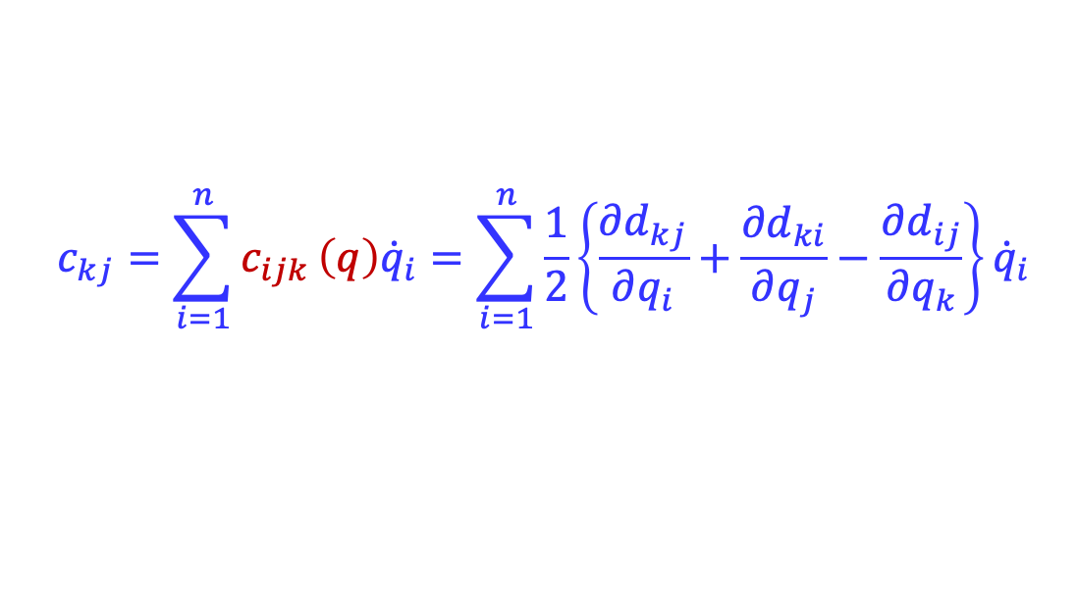
Using MATLAB to Obtain the Model
Using Matlab Symbolic Toolbox to Derive the Model
%% D(q)ddq + C(q,dq)*dq + G(q) = tau
%% Calculate the matrix $C(q,\dot{q})$
syms C real
n=max(size(q));
for k=1:n
for j=1:n
C(k,j)=0;
for i=1:n
C(k,j)=C(k,j)+(1/2)*(diff(D(k,j),q(i))+diff(D(k,i),q(j))-diff(D(i,j),q(k)))*dq(i);
end
end
end
C
$$c_{kj}=\sum_{i=1}^{n}{c_{ijk}}\left(q\right){\dot{q}}_{i}=\sum_{i=1}^{n}{\frac{1}{2}\left\{\frac{{∂d}_{kj}}{∂q_{i}}+\frac{{∂d}_{ki}}{∂q_{j}}−\frac{∂d_{ij}}{∂q_{k}}\right\}{\dot{q}}_{i}}$$
Notes:
http://www.eecs.umich.edu/~grizzle/papers/Three_link_walker.zip
http://www.eecs.umich.edu/~grizzle/papers/Westervelt_Grizzle_five_link_walking_simulator.zip

Slide 34
Using MATLAB to Obtain the Model
• Very convenient to derive model, compute control laws, and perform simulations in a common environment:
– we have been using MATLAB
– model derived using SYMBOLIC TOOLBOX
– m-files for ODE45 or Simulink are automatically generated from the symbolic computations
– relevant files can be downloaded at
http://www.eecs.umich.edu/~grizzle/papers/Three_link_walker.zip
J.W. Grizzle, Gabriel Abba and Franck Plestan, Asymptotically Stable Walking for Biped Robots: Analysis via Systems with Impulse Effects, IEEE T-AC, Volume 46, No. 1, January 2001, pp. 51-64
http://www.eecs.umich.edu/~grizzle/papers/Westervelt_Grizzle_five_link_walking_simulator.zip
E.R. Westervelt, J.W. Grizzle, and D.E. Koditschek, Hybrid Zero Dynamics of Planar Biped Walkers. Published, IEEE-TAC, Vol. 48, No. 1, January 2003, pp. 42-56
Notes:
http://www.eecs.umich.edu/~grizzle/papers/Three_link_walker.zip
http://www.eecs.umich.edu/~grizzle/papers/Westervelt_Grizzle_five_link_walking_simulator.zip

Slide 35
Summary
Properties of Dynamic Equations
Generalized Forces
Impact Dynamics
Using MATLAB to Obtain the Model
Example：Dynamic Walking Model

Slide 36
Midterm Test
考试内容：
机器人基本概念
位姿描述与齐次变换
正运动学
逆运动学
速度运动学
动力学
Midterm Test
Time：April 21, 2025
10:20－12:10
Place：一教 326
考试方式：
半开卷—可看指定教材
5页内的A4纸笔记

